Slide 1


Image Classification
SkLearn vs PyTorch
Presented by: Jasmine DeHart

Slide 2

Would you like to be involved in research at the University of Oklahoma?
The purpose of this survey is to understand attendees' knowledge of Python and intended outcomes from attending these sessions. We are trying to gauge the demand of skills, resources, and knowledge of Python programming and associated techniques. This will, in turn, help us understand the success of the workshop and room for improvement.

Slide 3
Overview
Computer Vision Overview
What is Image Classification?
High Level Implementation Guide
Defining a Problem
Choose Approach
Gather Data
SciKit Learn
PyTorch

Slide 4

Computer Vision
Trains computers to interpret and understand the visual world.
Computer Vision
Image Classification
Object Segmentation
Instance Segmentation
Notes:
https://medium.com/zylapp/review-of-deep-learning-algorithms-for-object-detection-c1f3d437b852

Slide 5
What is Image Classification?
A common use of machine learning is to identify what an image represents.
The task of predicting what an image represents is called image classification.
An image classification model is trained to recognize various classes of images.

Slide 6
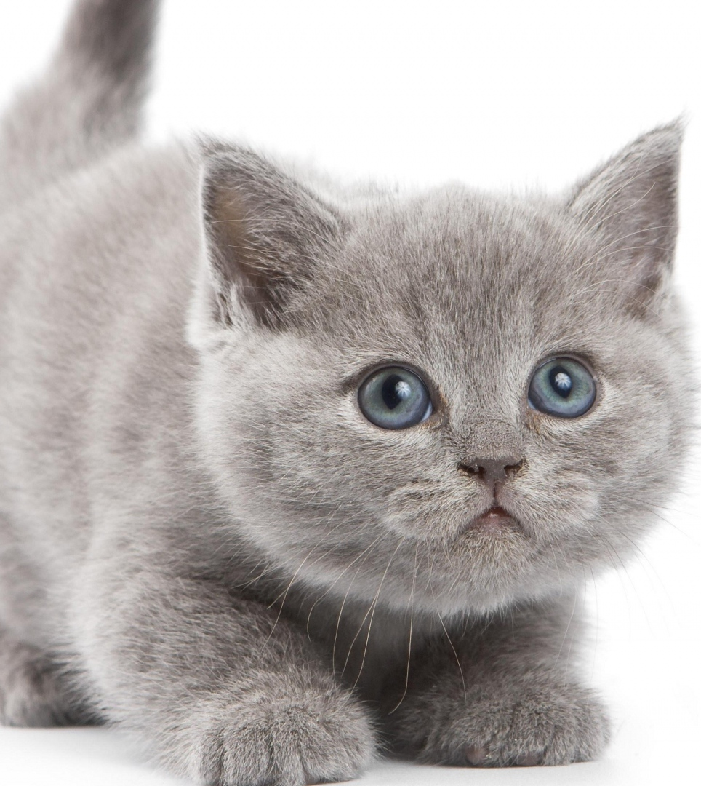
What is this image?
Animal Type | Probability
Cat | 0.88
Dog | 0.12
This Photo by Unknown Author is licensed under CC BY-NC

Slide 7
Define a Problem
Labeling an x-ray as cancer or not (binary classification).
Classifying a handwritten digit (multiclass classification).
Assigning a name to a photograph of a face (multiclass classification).
We can use binary classification (linear or logistic regression), decision trees, or clustering to solve many of our problems.
To pick a model, lets see what problem are you trying to solve?

Slide 8
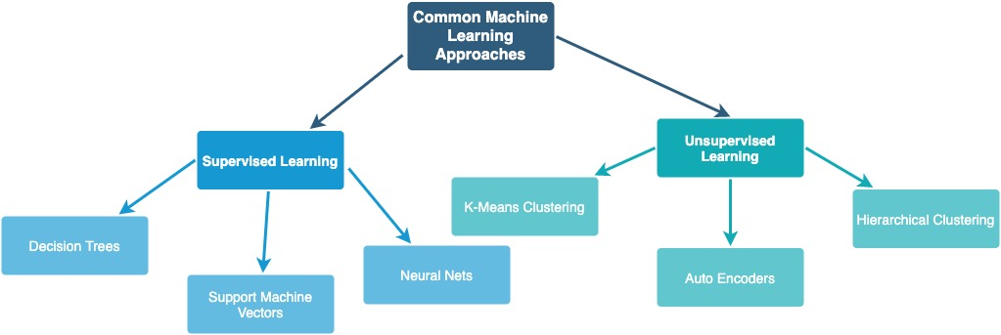
Choose the approach
What approach should we use to accomplish this task?

Slide 9
Gather Data
Existing Datasets
What to do when that data doesn’t exist?
ImageNet (http://image-net.org/about-overview)
Coco Dataset (http://cocodataset.org/#home)
Pascal VOC 2012 (http://host.robots.ox.ac.uk/pascal/VOC/)
Handwritten Digits (https://scikit-learn.org/stable/modules/generated/sklearn.datasets.load_digits.html#sklearn.datasets.load_digits)
Collect images
Split Training & Test data
Format files

Slide 10
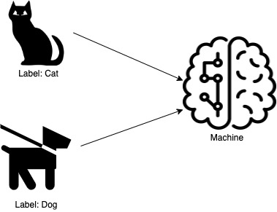
Supervised Learning: Training
Provide the machine learning algorithm categorized input to learn from

Slide 11
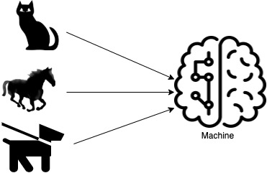
Supervised Learning: Predicting
Feed the machine new, unlabeled information to predict.

Slide 12
scikit-learn https://scikit-learn.org/stable/
Machine Learning in Python

Slide 13
What is scikit-learn?
Simple and efficient tools for predictive data analysis
Accessible to everybody, and reusable in various contexts
Built on NumPy, SciPy, and matplotlib
Open source, commercially usable

Slide 14
Building our scikit-learn model
Data: Handwriting Recognition
Algorithms: Random Forest Support Vector Machine
training and evaluation: Training- 80 Testing- 20

Slide 15
Random Forest
Creates set of decision trees from randomly selected subset of training set. It then aggregates the votes from different decision trees to decide the final class of the test object.
Notes:
It can be used for both classification and regression problems
Reduction in overfitting: by averaging several trees, there is a significantly lower risk of overfitting.
Random forests make a wrong prediction only when more than half of the base classifiers are wrong
It is very easy to measure the relative importance of each feature on the prediction. Sklearn as example has powerful library to do that.
https://blog.goodaudience.com/introduction-to-random-forest-algorithm-with-python-9efd1d8f0157
https://medium.com/machine-learning-101/chapter-5-random-forest-classifier-56dc7425c3e1

Slide 16
Support Vector Machines
The objective of the support vector machine algorithm is to find a hyperplane in an N-dimensional space(N — the number of features) that distinctly classifies the data points.
Notes:
The advantages of support vector machines are:
Effective in high dimensional spaces.
Still effective in cases where number of dimensions is greater than the number of samples.
Uses a subset of training points in the decision function (called support vectors), so it is also memory efficient.
Versatile: different Kernel functions can be specified for the decision function. Common kernels are provided, but it is also possible to specify custom kernels.
https://scikit-learn.org/stable/modules/svm.html
https://towardsdatascience.com/support-vector-machine-introduction-to-machine-learning-algorithms-934a444fca47

Slide 17
Pytorch https://pytorch.org/
Machine Learning in Python

Slide 18
What is PyTorch?
Scalable distributed training and performance optimization
Scalable distributed training and performance optimization
Built on TorchScript
Supported on major cloud platforms, providing frictionless development and easy scaling

Slide 19
Building our PyTorch model
Data
ReLU, Linear, LogSoftmax activation functions
Criterion
Epochs
Cross Entropy Loss
15
Algorithm: Neural Net
Handwriting Recognition

Slide 20
What is a Neural Network?
A neural network is a type of machine learning which models itself after the human brain, creating an artificial neural network that via an algorithm allows the computer to learn by incorporating new data.

Slide 21
Activation Functions
Activation functions are mathematical equations that determine the output of a neural network. The function is attached to each neuron in the network and determines whether it should be activated (“fired”) or not, based on whether each neuron’s input is relevant for the model’s prediction.

Slide 22
Our Activation Functions
Linear
RELU (Rectified Linear Unit)
Not possible to use backpropagation (gradient descent) to train the model
All layers of the neural network collapse into one— a linear activation function turns the neural network into just one layer.
Computationally efficient—allows the network to converge very quickly
Non-linear—although it looks like a linear function, ReLU has a derivative function and allows for backpropagation
Notes:
https://missinglink.ai/guides/neural-network-concepts/7-types-neural-network-activation-functions-right/

Slide 23
Output Function: Softmax
Able to handle multiple classes only one class in other activation functions—normalizes the outputs for each class between 0 and 1, and divides by their sum, giving the probability of the input value being in a specific class.
Useful for output neurons—typically Softmax is used only for the output layer, for neural networks that need to classify inputs into multiple categories.

Slide 24
Concepts: Criterion and Gradient Descent
The function we want to minimize or maximize is called the objective function or criterion. When we are minimizing it, we may also call it the cost function, loss function, or error function.
Gradient descent is an optimization algorithm used to find the values of parameters (coefficients) of a function (f) that minimizes a cost function (cost).
Notes:
https://machinelearningmastery.com/gradient-descent-for-machine-learning/

Slide 25
Concepts: Learning Rate, Momentum, Epochs
Learning Rate
The amount that the weights are updated during training is referred to as the step size or the “learning rate.”
Momentum
Epochs
Momentum can smooth the progression of the learning algorithm that, in turn, can accelerate the training process.
One Epoch is when an ENTIRE dataset is passed forward and backward through the neural network only ONCE.

Slide 26
Questions?
Thank you!

Slide 27

Would you like to be involved in research at the University of Oklahoma?
The purpose of this survey is to understand attendees' knowledge of Python and intended outcomes from attending these sessions. We are trying to gauge the demand of skills, resources, and knowledge of Python programming and associated techniques. This will, in turn, help us understand the success of the workshop and room for improvement.

